Slide 1

Large-Scale Long-Tailed Recognition in an Open World
presented by
Junyu Yin
Yudong Zhou
9 April 2022
Liu, Ziwei, et al. "Large-Scale Long-Tailed Recognition in an Open World.“ CVPR, 2019.

Slide 2
Outline
Motivation
Related Work
Imbalanced Classification
Few-Shot Learning
Open-Set Recognition
Methodology
Intuitive Explanation
Overview
Components
Results
Conclusions & Future Work

Slide 3
Motivation
asdsad

Slide 4
Motivation

Slide 5
Related Work
Imbalanced Classification
TBD

Slide 6
Related Work
Few-Shot Learning
TBD

Slide 7
Related Work
Open-Set Recognition
TBD

Slide 8
Methodology
Intuitive Explanation

Slide 9
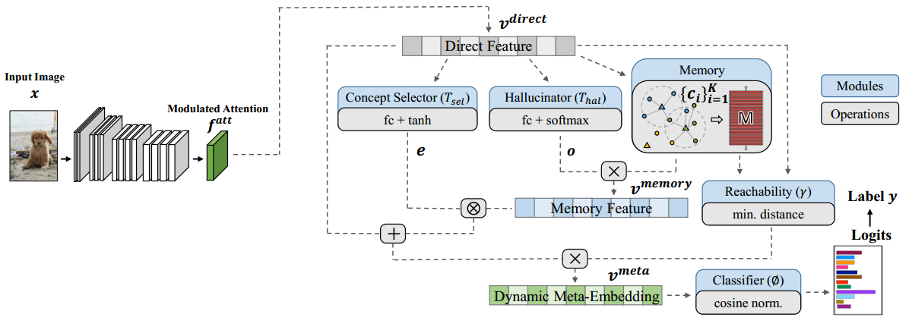
Methodology
Overview
Two main modules: dynamic meta-embedding & modulated attention
One important submodule: reachability

Slide 10
Methodology
Dynamic Meta-embedding
TBD

Slide 11
Methodology
Modulated Attention
TBD

Slide 12
Methodology
Reachability
TBD

Slide 13
Results

Slide 14
Conclusion

Slide 15
Thanks for your listening!

